Slide 1

CoreHealthCare Data Pipeline Design
A Comprehensive End-to-End Solution for Healthcare Data Management
oe
by osagie eboigbe

Slide 2

Project Overview
1
Objective
Design an end-to-end data pipeline for CoreHealthCare to handle the increasing volume of patient data, clinical records, and operational metrics.
2
Key Components
1. Data Ingestion 2. Data Processing & Transformation 3. Data Storage & Management 4. Pipeline Orchestration & Monitoring

Slide 3
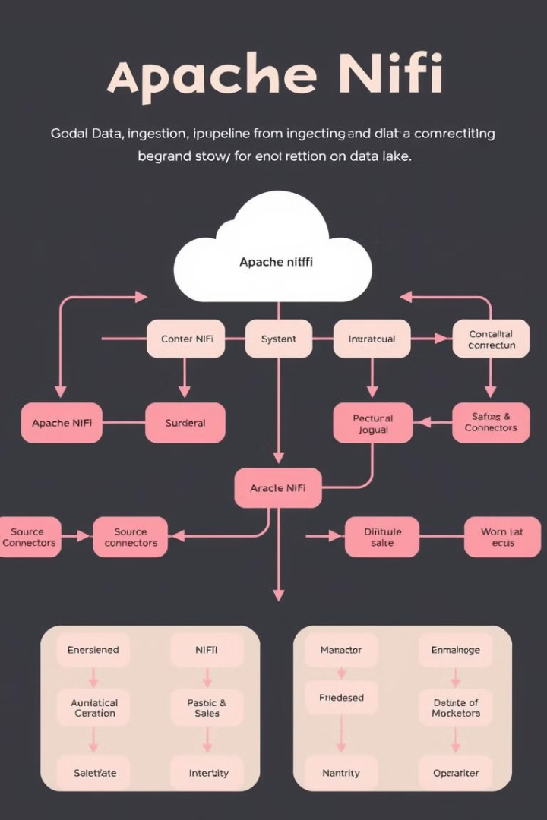
Data Ingestion Strategy
Objective
Design a strategy to ingest data from multiple sources into a central repository.
Key Decisions
Use Apache NiFi for automated data flow management. Implement batch processing for structured EHR data and real-time processing for IoT data. Ensure data consistency and reliability with validation checks and redundant pipelines.

Slide 4

Data Processing & Transformation
Objective
Key Decisions
Clean, transform, and enrich the ingested data.
Use Apache Spark for batch processing and Apache Flink for real-time processing. Implement data validation and cleaning steps to ensure data quality. Design the pipeline to scale horizontally, supporting increasing data volumes.

Slide 5

Data Storage & Management
Objective
Design the storage architecture to support efficient querying, analysis, and long-term management.
1
2
3
Key Decisions
Use AWS S3 for raw data storage and Amazon Redshift for structured data. Implement data partitioning and indexing to optimize performance. Ensure security with encryption, access control, and compliance with HIPAA regulations.

Slide 6
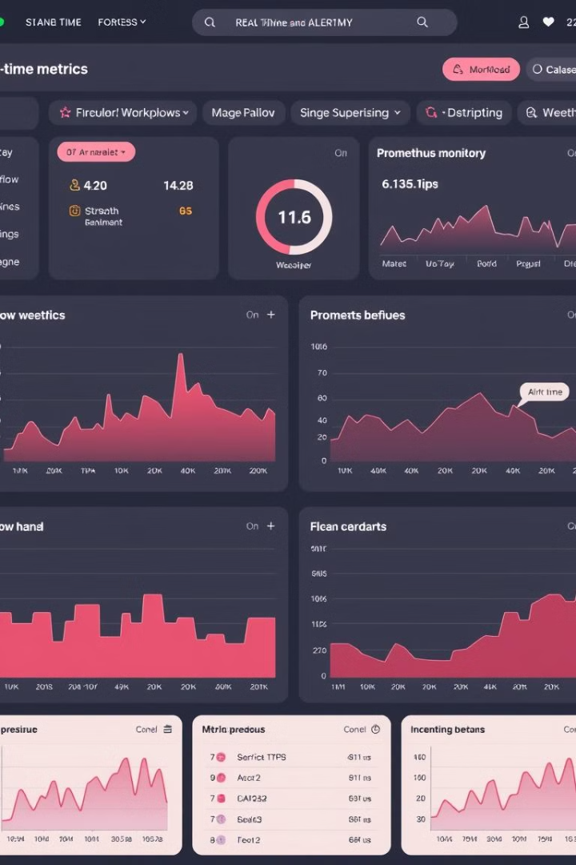



Pipeline Orchestration & Monitoring
Apache Airflow
For orchestration of batch jobs and workflow management
Prometheus
For real-time monitoring and alerting
ELK Stack
For centralized logging and troubleshooting

Slide 7



Conclusion & Next Steps
Conclusion
The designed data pipeline addresses CoreHealthCare's need for scalable, reliable, and efficient data management.
Next Steps
Review and finalize the design with CoreHealthCare's leadership team. Prepare for the implementation phase, focusing on the integration of selected tools and technologies.

